Slide 1

The Intersection of Government and Economy
A Sociological Approach
Name | ID
Al Sifat Siddiki | 2222495030
Afrin Azhar Fiza | 2221654630
Fayej Ahmed | 2221373048
Saif Zaman | 1931587642
Hasanul Karim | 2212632643

Slide 2
Presentation Outline
Introduction To The Topic
Power Of Authority And Its Impact On The Economy
(USA And China)
Types Of Government
Role Of Government
Changing Economies
Economic Indicators

Slide 3
Economic Systems
Economic System | Capitalism | Socialism | Communism | Islamic Economic System | Mixed Economy | Informal Economy
Ownership of Assets | Private Ownership | Public Ownership | Public Ownership | Private Ownership | Public and Private Ownership | No legal ownership
Decision Making | Decentralized | Centralized | Centralized | Decentralized | Combination of both | Decentralized
Government Role | Limited | Significant | Totalitarian | Significant | Significant | Minimal
Price Control | Low | High | High | Moderate | Moderate | None
Competition | High | Low | None | Moderate | Moderate to High | None
Resource Allocation | Market Forces | Planned | Planned | Combination of both | Combination of both | No formal resource allocation
Income Equality | Low | High | High | Moderate | Moderate to High | Low
Economic Efficiency | High | Low | Low | Moderate | Moderate to High | Low
Innovation | High | Low | Low | Moderate | Moderate to High | Low

Slide 4

What is a Political System?
A political system can be defined as a set of institutions, organizations, and processes through which a society governs itself.
Sociologists are interested in how individuals and groups interact socially and how that affects larger political systems.

Slide 5

Key factors to remember
Authority
Key Verdict
Power
.
Authority, on the other hand, refers to the legitimate use of power.
Authority is seen as legitimate because it is based on accepted norms and rules.
In sociology, power and authority are important concepts because they help us to understand how social relations are structured and how social change is achieved. By analyzing the distribution of power and authority in society, sociologists can identify patterns of inequality and oppression, and develop strategies for challenging and transforming existing structures of governance.
Power refers to the ability of an individual or group to influence the behavior of others, often against their will.
Power can be exercised in various ways, such as through coercion, persuasion, or manipulation.

Slide 6

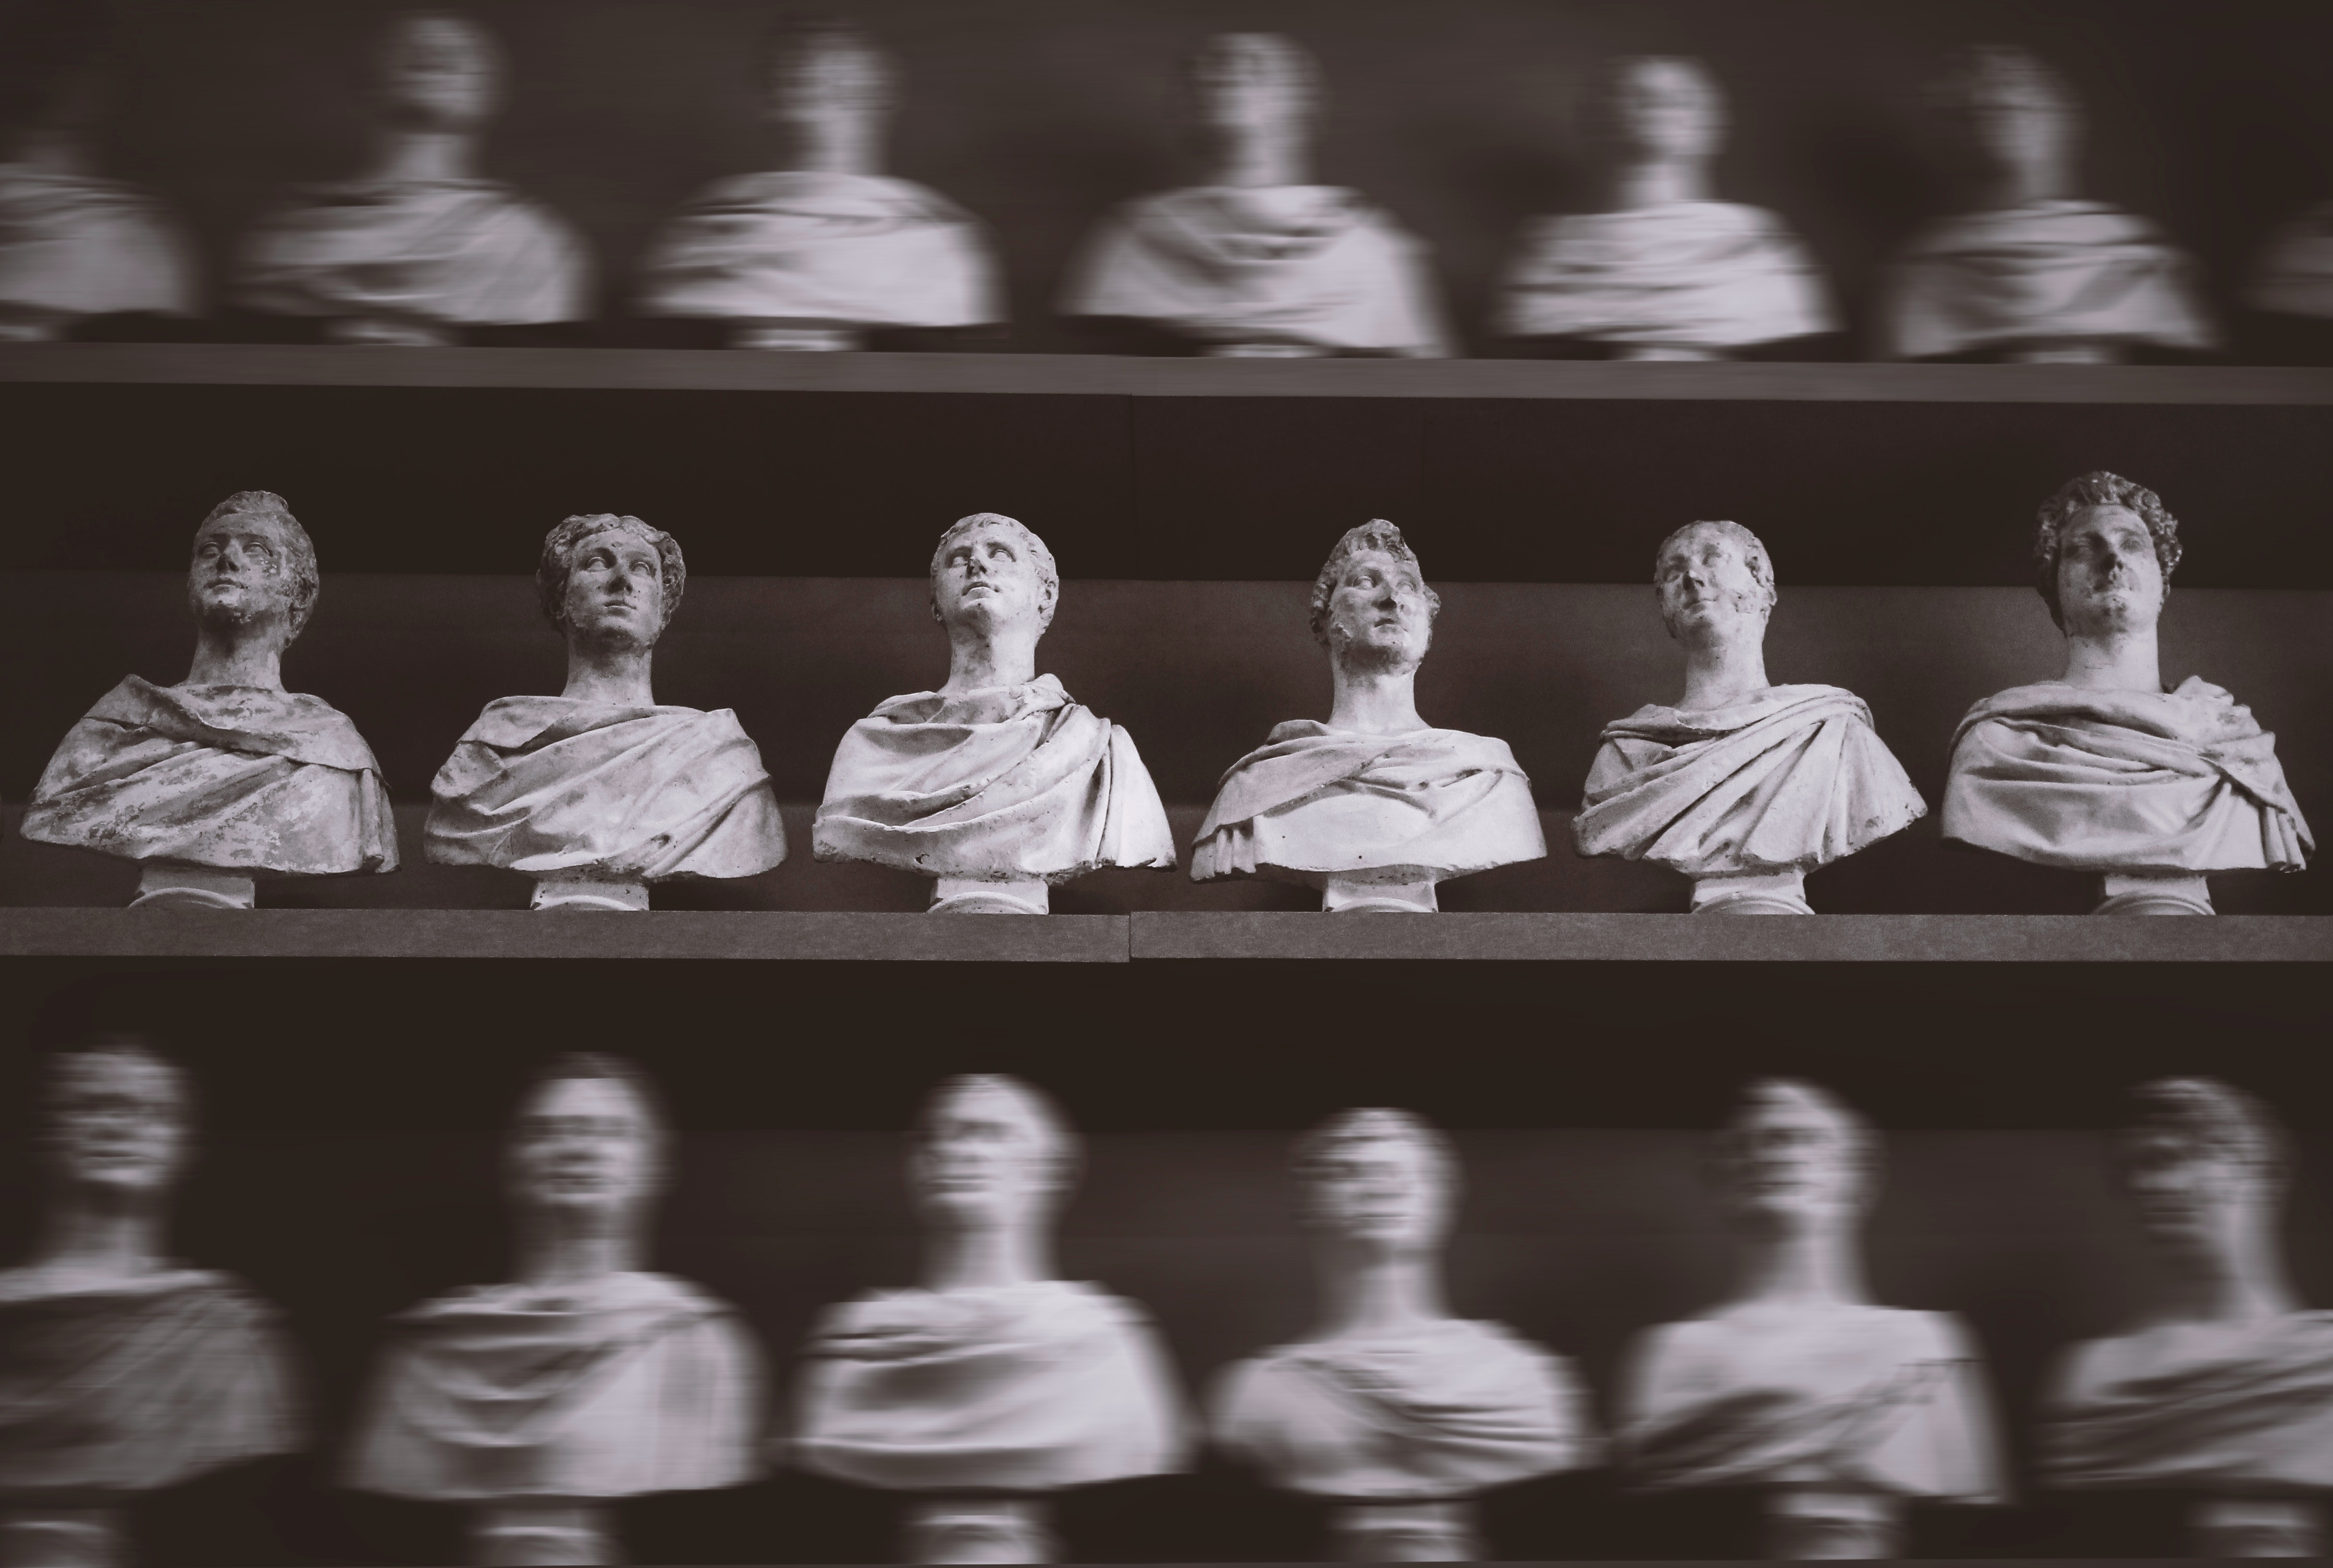
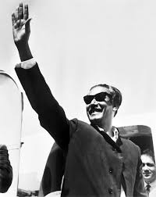

Power and Authority (in depth)
Power comes from a variety of sources in political systems, including:
Force: the actual or implied use of coercion to impose one's will on others.
Influence is the use of persuasion to exercise power.
There are three ideal forms of authority:
Traditional Authority: rightful control granted by established practice and custom.
Rational-legal Authority refers to the established norms and regulations that govern political systems.
Charismatic Authority: the legitimacy of a leader's position based on the unique emotional or personal appeal made to followers.

Slide 7
Types of Government
Every society creates a political structure through which it is governed.
These formal systems of government in contemporary industrialized countries make a sizable number of crucial political decisions.
There are 5 forms of government:
Monarchy
Oligarchy
Democracy
Dictatorship
Totalitarianism

Slide 8
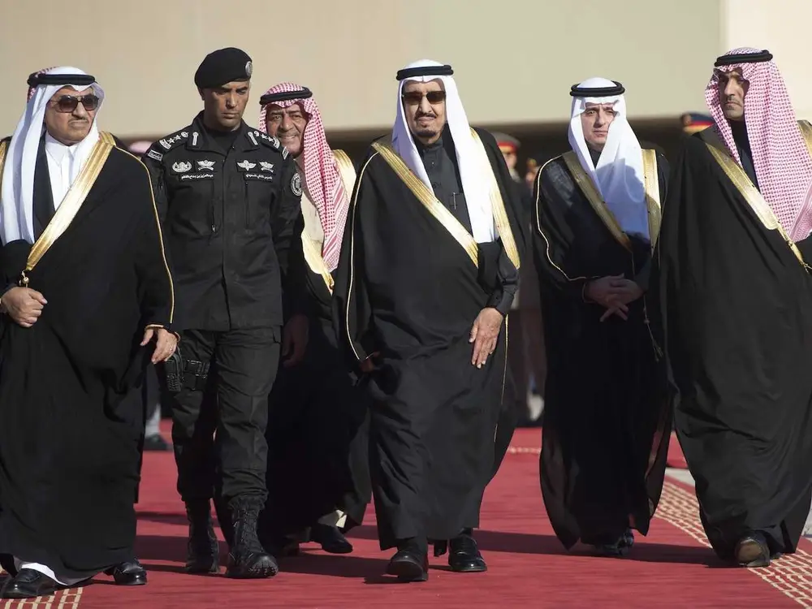
Monarchy
A monarchy is a form of government in which a single ruler, typically a king or queen, holds supreme power.
The monarch's power is usually inherited, and the system is often characterized by a hierarchical structure with the monarch at the top.
Examples of monarchies include the United Kingdom, Saudi Arabia, and Sweden.

Slide 9
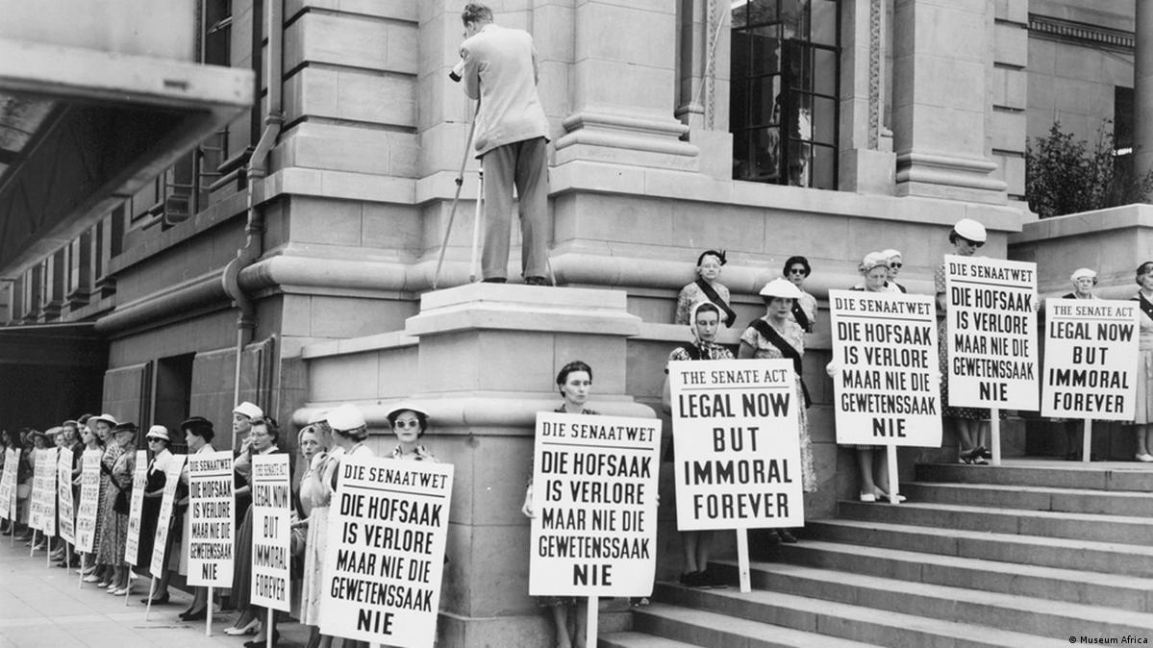
Oligarchy
An oligarchy is a form of government in which a small group of individuals, often wealthy or influential, hold power.
The group may be based on social class, ethnicity, or other factors, and they often use their power to maintain their position and influence government policies.
Examples of oligarchies include the former Soviet Union, China, and South Africa during apartheid.

Slide 10
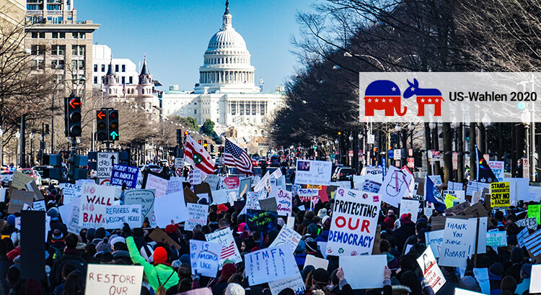
Democracy
Democracy is a form of government in which power is vested in the people, who participate in the decision-making process through free and fair elections.
Democracy is based on the principles of equality, freedom, and justice, and it seeks to promote the well-being of all members of society.
In a democracy, the people have the right to participate in the political process and to hold their elected representatives accountable. The government is structured around the rule of law, and all citizens are equal before the law.

Slide 11
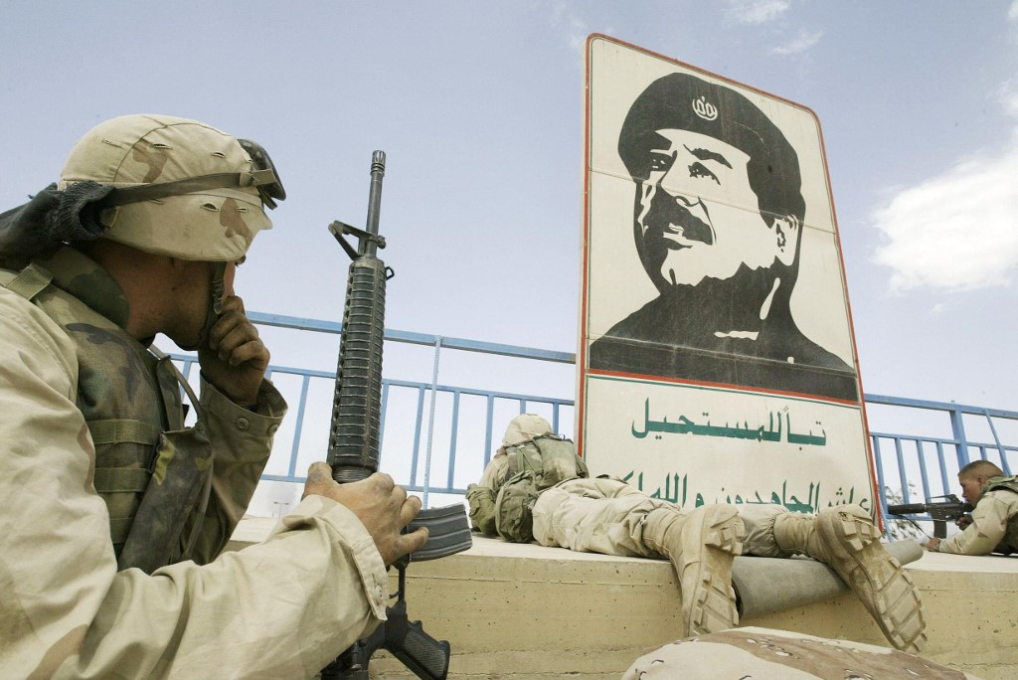
Dictatorship
A dictatorship is a form of government in which a single individual, known as the dictator, holds absolute power.
The dictator may come to power through a coup, election, or other means, and they often use force and intimidation to maintain their position.
Examples of dictatorships include Saddam Hussein's regime in Iraq, Idi Amin's regime in Uganda, and the current regime in North Korea.

Slide 12
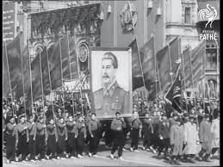
Totalitarianism
Totalitarianism is a form of dictatorship in which the government exercises total control over all aspects of society, including politics, the economy, and social life.
The state controls information, media, and education, and individuals are expected to conform to the state's ideology and values.
Examples of totalitarian regimes include Nazi Germany, Soviet Union under Stalin, and North Korea under Kim Jong Un.

Slide 13






Role of the Government
03
04
Promoting social welfare
Fostering economic development
02
05
Regulating and enforcing laws
Protecting national security
01
06
Providing public goods and services
Addressing social and economic inequality

Slide 14
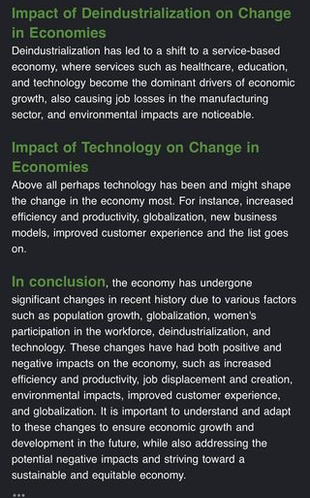
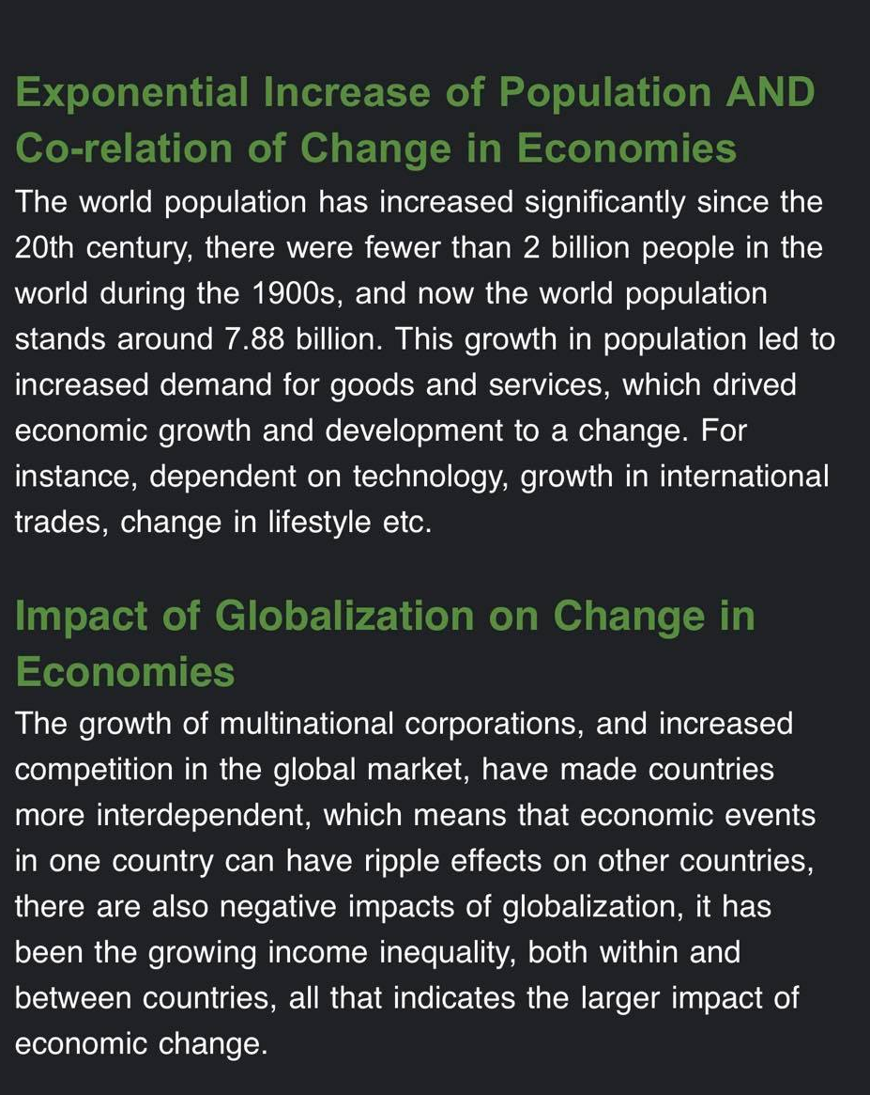
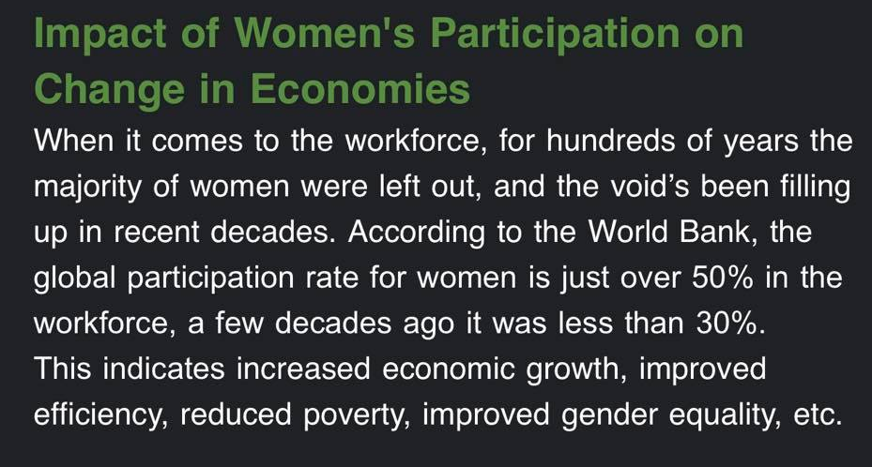
Changing Economies
Unemployment

Slide 15
Economic Indicators
Economic indicators are measures of economic activity that sociologists use to understand and analyze the economy. In sociology, economic indicators are used to study inequality, poverty, social mobility, and other economic and social issues.
GDP
GDP is a measure of the total value of goods and services produced in a country during a specific period of time.
Income Inequality
Income inequality is the unequal distribution of income among individuals or households within a society
Poverty
Poverty is a condition in which people lack the resources to meet their basic needs, such as food, shelter, and healthcare
Unemployment
Unemployment is a situation in which people who are willing and able to work are unable to find employment
Consumer Price Index
The CPI is a measure of the average change in prices of a basket of goods and services over time
Economic indicators are essential tools for sociologists to study the economy and its effects on society. However, these indicators should be used in conjunction with other sociological perspectives and methods to provide a complete understanding of economic issues.

Slide 16

Analysis of the government policies
The US government has implemented policies aimed at promoting economic growth and job creation, such as tax cuts and deregulation.
The government has also invested in infrastructure and education, and has implemented policies to support small businesses and entrepreneurs.
Positive and negative effects on the economy
The policies implemented by the US government have contributed to economic growth and job creation, and have helped to support the country's position as a global economic leader.
However, these policies have also contributed to rising income inequality and have had negative effects on the environment and public health.
Economic indicators of the economy
The US economy is the largest in the world, with a GDP of $21.4 trillion in 2019.
Unemployment has been relatively low in recent years, hovering around 3.5% in 2019.
Analysis of the US economy
Recommendations for the USA:
Implement policies to address income inequality, such as progressive taxation and increased support for social safety net programs.
Implement policies to address climate change and promote environmental sustainability, such as investing in renewable energy and reducing carbon emissions.

Slide 17

Analysis of the Chinese economy
Analysis of the government policies
The Chinese government has implemented policies aimed at promoting economic growth and modernization, such as the Belt and Road Initiative and the Made in China 2025 plan.
The government has also implemented policies to promote innovation and entrepreneurship, and has invested heavily in infrastructure and technology.
Positive and negative effects on the economy
The policies implemented by the Chinese government have contributed to rapid economic growth and modernization, and have helped to lift millions of people out of poverty.
However, these policies have also contributed to environmental degradation, social inequality, and human rights violations.
Economic indicators of the economy
The Chinese economy is the second-largest in the world, with a GDP of $14.1 trillion in 2019.
However, income inequality has also been on the rise, with the top 1% of households holding more wealth than the bottom 50%.
Recommendations for China:
Address environmental degradation and pollution by implementing policies to reduce carbon emissions and promote sustainable development.
Address human rights violations, including those related to labor rights and freedom of speech, by implementing policies to protect the rights of workers and promote greater autonomy for individuals.

Slide 18
Conclusion
The presentation focuses on the intersection of government and economy.
The impact of government policies on the economy is discussed.
Case studies of USA and China are presented to analyze the effects of government policies on their respective economies.
The positive and negative effects of government policies on the economy are examined, as well as economic indicators of each country.
Recommendations for better management of the situations are provided, along with the role of government in managing the economy and the importance of understanding changing economies.

Slide 19
Thank you!

